Slide 1

Climate Change after The Hague:
Implications for the Energy Sector
Henry D. Jacoby
MIT Joint Program on the Science and Policy of Global Change
NEMS/AEO Conference
27 March 2001

Slide 2
Climate Change after The Hague
Deadlock at COP-6 . . . should we care?
The Path from Rio to The Hague
W(h)ither the international negotiations?
What to do while diplomats struggle?
Implications for the energy sector
Final thoughts

Slide 3
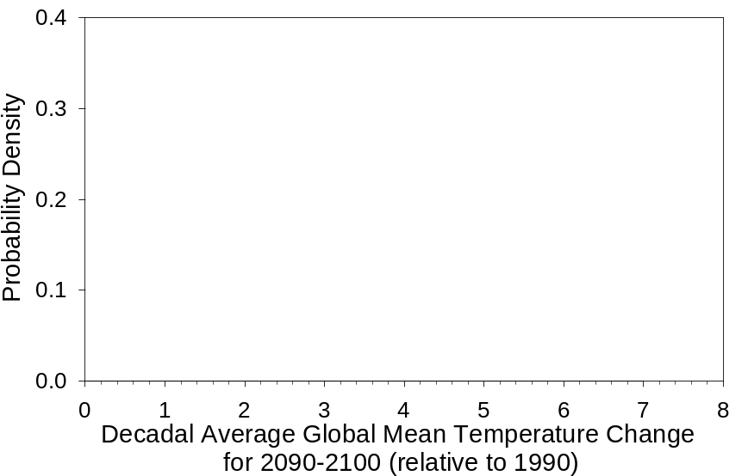
IPCC on 21st Century Temperature Change, No Policy
IPCC Lower Bound: 1.4°C
IPCC Upper Bound: 5.8°C

Slide 4
21st Century Climate Outlook
MIT Integrated Global System Model
  Economic growth, technical change and emissions
  Climate model of intermediate complexity
    All gases & aerosols: urban and atmospheric chemistry
    Atmospheric dynamics, ocean circulations
    Impacts on terrestrial ecosystems, & feedbacks
Projection of 21st Century climate, considering
  Key economic uncertainties influencing emissions
  Uncertainty in atmosphere and ocean processes
  Uncertainty in aerosol forcings
Notes:
ECON: Parameter uncertainty, some history based, some judgmental
CLIMATE: Conditioned by historical data

Slide 5
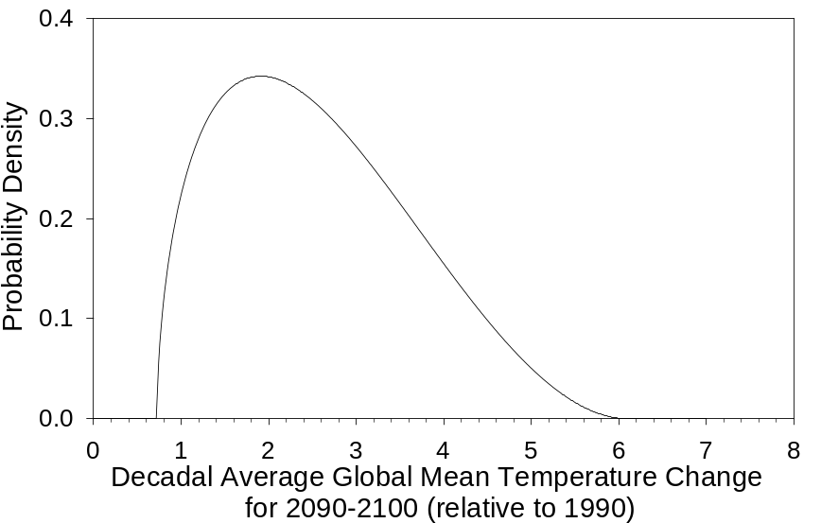
Outlook for 21st Century Temperature Change, No Policy
Lower 95% Bound: 0.91°C
Upper 95% Bound: 4.79°C
IPCC Lower Bound: 1.4°C
IPCC Upper Bound: 5.8°C
Median: 2.46°C

Slide 6
The Path from Rio to The Hague
Rio (1992): the Framework Convention
  Deal with climate in the UN context
  Concept of quantity targets, and a timetable
Berlin (1995): the Berlin Mandate
  “Common but diff.” ➔ ➔ Annex I/Non-Annex I split
  Seek (by 1997) national targets for 2005, 2010, 2020
Kyoto (1997): the Kyoto Protocol
  Agreed 2008-2012 targets . . . but NOT key definitions!
  Entry into force if get 55% of 1990 Annex I emissions
Ran ahead of political support in key nations!

Slide 7
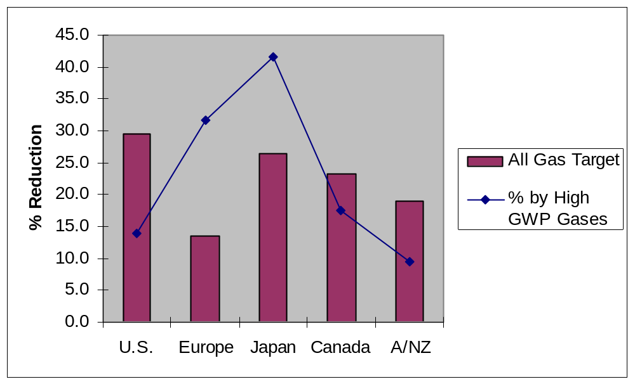
Kyoto Commitments:
Estimated % Reduction Below 2010 Baseline

Slide 8
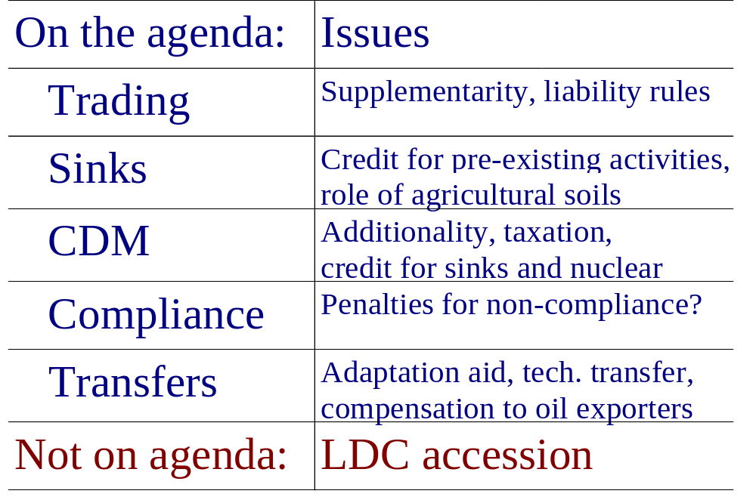
COP-6 : The Unfinished “Details”

Slide 9
COP-6 In The Hague, Nov. 2000
Breakdown: EU vs. the Umbrella Group
  EU: insist on domestic fossil fuel reductions
  US (& UG): Max flex for any hope of ratification
Particular points of US-EU disagreement
  Crediting of BAU sinks in forests & soils
  Limits on use of reductions purchased abroad
Other deal-stoppers in the wings
  Adaptation aid, technology transfer, compensation
  Penalties for non-compliance

Slide 10
Where Are We Headed?
Into force: EU + USA?
YES
Kyoto as written
NO
The Hague
YES
Agree COP-6 Details?
Into force: w/o USA?
YES
Euro “Club”
NO
NO
Return to Kyoto?
Into force?
Renew Negotiations
Separate Paths?
Return to Rio?
?

Slide 11
If COP-6-bis ➔ COP-7, 8, 9, etc. What To Do While Waiting?
Situation: distrust ➔ confusion for several years
. . . but many national programs will proceed
So . . . shift focus ➔ intermediate gains
– R&D and technology diffusion (open options)
– Domestic actions on emissions (build trust)
– LDC aid & capacity building (need them!)
– Develop accounting guidelines (ease convergence)
Notes:
(issue is not how to count, b t how much!)

Slide 12
Implications for the Energy Sector
For the U.S. government:
– Removal of a barrier: “backdoor implementation”
– Opportunity: energy policy is focus after years of neglect
    Wider scope for tradeoffs
    Opening to grand bargain: energy/environment
(Of course, opportunities are often missed! )
For firms:
– Out front with voluntary program? Now even more so!
– Divergence of business conditions across countries

Slide 13
Final Thoughts
The climate issue is not going away
We are running a big risk!
COP-6: was a debacle . . .
But also opens new opportunities!
No hope of mitigation without new technology
Which requires investment,
And a non-zero carbon price.

